Slide 1

WELCOME
Mobile Application Development

Slide 2

Android Activity Lifecycle
In Android, an activity is referred to as one screen in an application. It is very similar to a single window of any desktop application. An Android app consists of one or more screens or activities. Each activity goes through various stages or a lifecycle and is managed by activity stacks. So when a new activity starts, the previous one always remains below it.
There are four stages of an activity.
If an activity is in the foreground of the screen at the top of the stack, then it is said to be active or running. This is usually the activity that the user is currently interacting with.
If an activity has lost focus and a non-full-sized or transparent activity has focused on top of your activity. In such a case either another activity has a higher position in multi-window mode or the activity itself is not focusable in the current window mode. Such activity is completely alive.

Slide 3
Android Activity Lifecycle
If an activity is completely hidden by another activity, it is stopped or hidden. It still retains all the information, and as its window is hidden thus it will often be killed by the system when memory is needed elsewhere.
The system can destroy the activity from memory by either asking it to finish or simply killing its process. When it is displayed again to the user, it must be completely restarted and restored to its previous state.
For each stage, android provides us with a set of 7 methods that have their own significance for each stage in the life cycle.

Slide 4
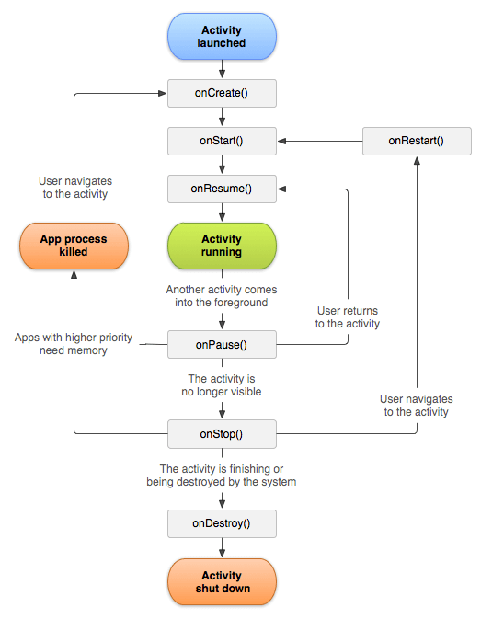
Android Activity Lifecycle
Method | Description
onCreate | called when activity is first created.
onStart | called when activity is becoming visible to the user.
onResume | called when activity will start interacting with the user.
onPause | called when activity is not visible to the user.
onStop | called when activity is no longer visible to the user.
onRestart | called after your activity is stopped, prior to start.
onDestroy | called before the activity is destroyed.

Slide 5
Android Activity Lifecycle Example
1. File: activity_main.xml
<?xml version="1.0" encoding="utf-8"?>
<LinearLayout xmlns:android="http://schemas.android.com/apk/res/android"
xmlns:app="http://schemas.android.com/apk/res-auto"
xmlns:tools="http://schemas.android.com/tools"
android:layout_width="match_parent"
android:layout_height="match_parent"
android:orientation=" vertical"
tools:context="example.javatpoint.com.activitylifecycle.MainActivity">
<TextView
android:layout_width="wrap_content"
android:layout_height="wrap_content"
android:text="Hello World!" />
</LinearLayout>

Slide 6
Android Activity Lifecycle Example
File: MainActivity.java
package example.javatpoint.com.activitylifecycle;
import android.app.Activity;
import android.os.Bundle;
import android.util.Log;
public class MainActivity extends Activity {
@Override
protected void onCreate(Bundle savedInstanceState) {
super.onCreate(savedInstanceState);
setContentView(R.layout.activity_main);
Log.d("lifecycle","onCreate invoked");
}

Slide 7
Android Activity Lifecycle Example
OnStart
@Override
protected void onStart() {
super.onStart();
Log.d("lifecycle","onStart invoked");
}
OnPause
@Override
protected void onPause() {
super.onPause();
Log.d("lifecycle","onPause invoked");
}
OnResume
@Override
protected void onResume() {
super.onResume();
Log.d("lifecycle","onResume invoked");
}
OnStop
@Override
protected void onStop() {
super.onStop();
Log.d("lifecycle","onStop invoked");
}

Slide 8
Android Activity Lifecycle Example
OnRestart
@Override
protected void onRestart() {
super.onRestart();
Log.d("lifecycle","onRestart invoked");
}
OnDestroy
@Override
protected void onDestroy() {
super.onDestroy();
Log.d("lifecycle","onDestroy invoked");
}
}

Slide 9
Thank You

